Slide 1

H1-B Visa Approval Analysis Prediction Using ML Algorithms
Project Supervisor : Ms.R.Aishwarya
Name of the Student : Mr.Pagadala Siva Tharun
Register Number: 39110727

Slide 2
Presentation Outline
Course Certificate
Introduction
Objectives
Block Diagram / Ideation Map
Project Implementation
Results and Discussions
Conclusion
Model Screenshots
References

Slide 3
Course Certificate

Slide 4
Introduction
The H-1B visa allows only a small proportion of individuals to work in the United States. This type of visa are applied by a number of highly skilled foreign nationals.The visa request is applied by the foreign national’s company to the US embassy. So, one year of experience counts as one point. Hence, the user has to collect a total of 12 points in order to qualify for the visa. The chances of getting accepted are very slim due to the restrictions imposed by the United States Government. It has become even more difficult to secure the H-1B visa due to the changes in the procedures and the laws. In this paper, the proposed system plays the role of predicting the corresponding petition issued for a H-1B visa. The selection depends upon aplethora of factors such as wage,employer, work experience, proficiency, field of work and
many more. Our proposed model takes into account all such factors and using ANN algorithm predicts the outcome of the visa application. The dataset taken consists of 2 million petitions which allows the model to predict more accurately. The dataset was then cleaned by removing the outliers and then applied one hot encoding to convert the data into numeric form for further processing. Finally, the AUC and ROC

Slide 5
Objectives
H-1B Visa is the most sought-after non-immigrant visa that allows foreign workers to work in United States in specialty occupation. In 2019, more than 1 million applicants applied to get an H-1B visa including new applications, renewals and transfer of H-1B to another company. There were more than 180,000 new applicants for H-1B , however, only 80,000 applications were picked up in the lottery process for taking it further to USCIS for approval. The uncertainty in getting an H-1B visa creates employment and legal status uncertainties for a job application and high legal and visa processing fees for the organization over the period of employment. We plan to use the anonymized dataset for 2019 that United Status Department of Labor publishes publicly and apply data science techniques to improve predictability of approval in this project.

Slide 6
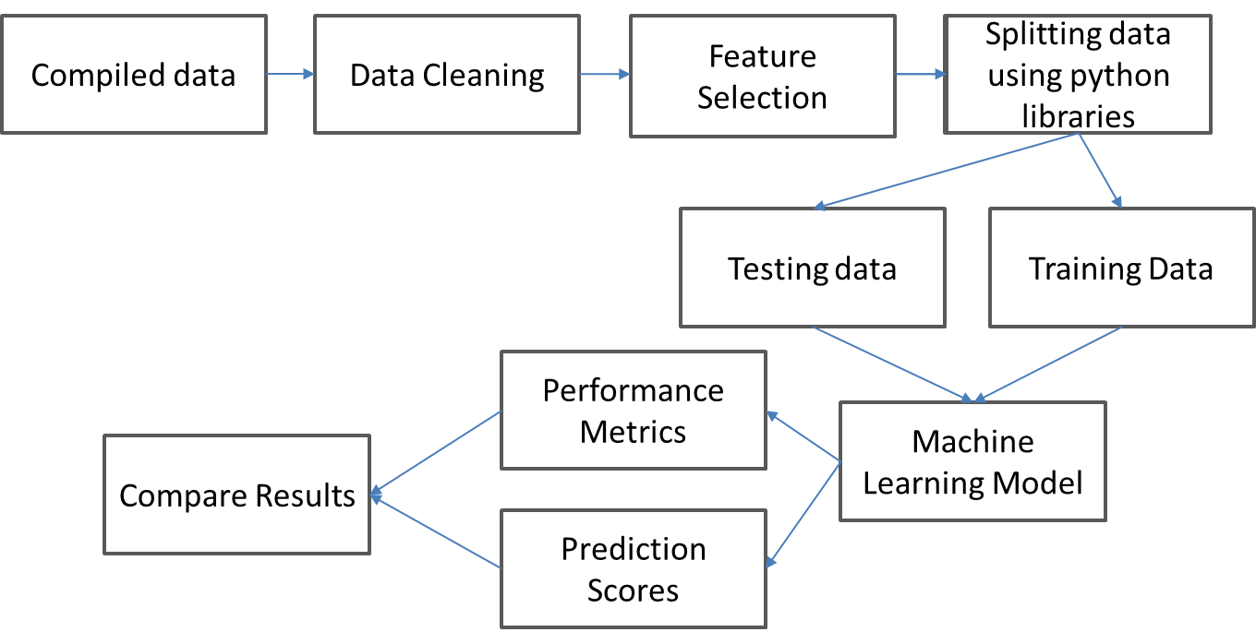
Block Diagram / Ideation Map

Slide 7
Project Implementation
Languages Used
Python and ML Algorithms
SOFTWARE / HARDWARE REQUIREMENTS
Google Co-Laboratory
VS(Visual Studio) Code
Python 3.10.4

Slide 8
Project Implementation
Steps involved in Project Implementation
Dataset
Data Preprocessing
Feature Selection
Train, Test and Split
Model Implementation using ML Algorithms
Model Accuracy Testing

Slide 9
Methodology
MODEL REQUIREMENTS
NON FUNCTIONAL REQUIREMENTS
EFFICIENCY REQUIREMENT
The ML Model should efficiently load and search data and perform the predictions efficiently.
RELIABILITY REQUIREMENT
The ML Model should accurately perform ckd predictions, and generates the result .
USABILITY REQUIREMENT
The Model UI is designed to be a user-friendly environment so that users can understand the fields in detail
IMPLEMENTATION REQUIREMENTS
In the implementation, the Model uses the python and ML Algorithms for predicting certified.
DELIVERY REQUIREMENTS
The whole Model is expected to be delivered in few days with a weekly evaluation by the project guide.

Slide 10
Methodology
ALGORITHMS USED
Random Forest Classifier - Random Forest is a classifier that contains a number of decision trees on various subsets of the given dataset and takes the average to improve the predictive accuracy of that dataset.
Logistic Regression - Logistic regression is one of the most popular Machine Learning algorithms, which comes under the Supervised Learning technique. it is used for predicting the categorical dependent variable using a given set of independent variables. Logistic regression predicts the output of a categorical dependent variable.

Slide 11
Methodology
MODEL OBJECTIVE
The Office of Foreign Labor Certification (OFLC) generates program data, including data about H1-B visas. The disclosure data is updated annually and is available online. The H1B Visa is a highly desired non-immigrant visa which permits foreign workers in specialty occupations to enter the country.
H-1B visas are a category of employment-based, non-immigrant visas for temporary foreign workers in the United States. For a foreign national to apply for H1-B visa, a US employer must offer them a job and submit a petition for a H-1B visa to the US immigration department.
This is also the most common visa status applied for and held by international students once they complete college or higher education and begin working in a full-time position .Our model predicts the h1-b visa of predictions based on the fields filled by the user’s and decides the visa application whether it is Certified or Denied

Slide 12
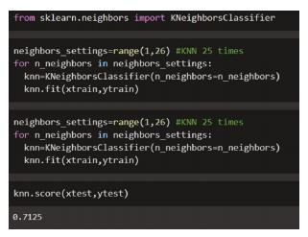
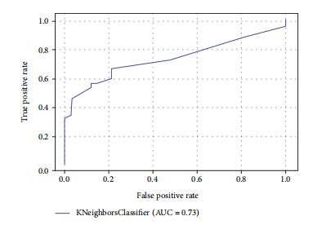
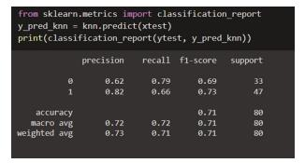
Results and Discussion
RF Classifier
Figure–(1) shows the Random Forest classifier’s classification accuracy. Here, the accuracy is lower than with other algorithms. Even after fine tuning, this accuracy did not improve further. Figure –(2) shows the classification report of the Random Forest algorithm. The overall performance of Random Forest is unsatisfactory. The overall r2-score obtained here is 71%. Individual r2-scores for DENIED are 69 percent and 73 percent for CERTIFIED. Figure-(3) depicts the Random Forest classifier’s AUC curve. The Random Forest classifier has a 73 percent accuracy under the curve. As well as the model’s calculated performance, the confusion matrix displays the predicted outcome. There were 57 accurate predictions, but there were also 23 erroneous predictions.

Slide 13
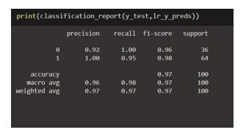
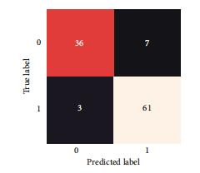
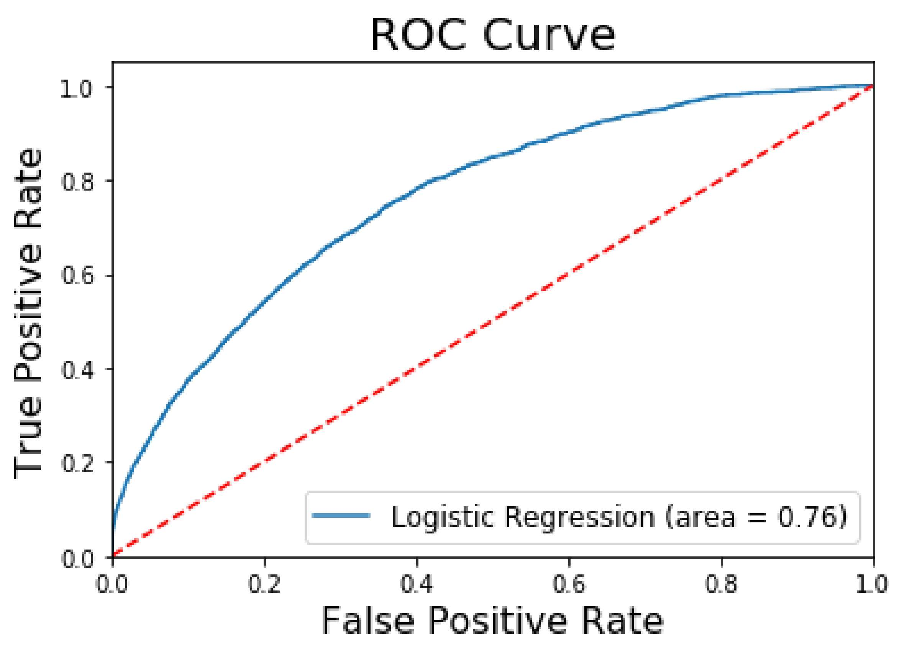
Results and Discussion
Logistic Regression
The report of the LR model is shown in Figure 4. This model has the best accuracy in classifying objects. In this case, the total F1-score obtained is percent. Individuals without CERTIFIED have an r2-score of 98 percent, whereas those with CERTIFIED have a score of 98 percent. The AUC curve for the logistic regression classifier is shown in Figure 5. The accuracy under the curve is 100 percent in this case. Figure 6 shows the final prediction of the logistic regression model. As well as the model’s calculated performance, the confusion matrix displays the predicted outcome. There were 97 correct forecasts and three incorrect forecasts, for a total accuracy of 100 percent. LR Model got most accuracy in predicting output results for Prediction of CERTIFIED

Slide 14
Conclusion
According to the findings of the study, the decision tree approach and logistic regression can be used to predict h1-b visa approvall more accurately. According to the study, their precision was 98.25 percent, and their accuracy was 98 percent. Compared to prior research, the accuracy percent of the models used in this investigation is considerably higher, indicating that the models used in this study are more reliable than those used in previous studies. When cross validation measurements are used in the prediction of visa approval, the LR method outperforms the other processes. Future research may build on this work by developing a web application that incorporates these algorithms and using a bigger dataset than the one utilized in this study. This will enhance the dependability of the framework as well as the framework’s presentation. The hope is that it would encourage people to seek early treatment for chronic renal disease and to make improvements in their lives.

Slide 15
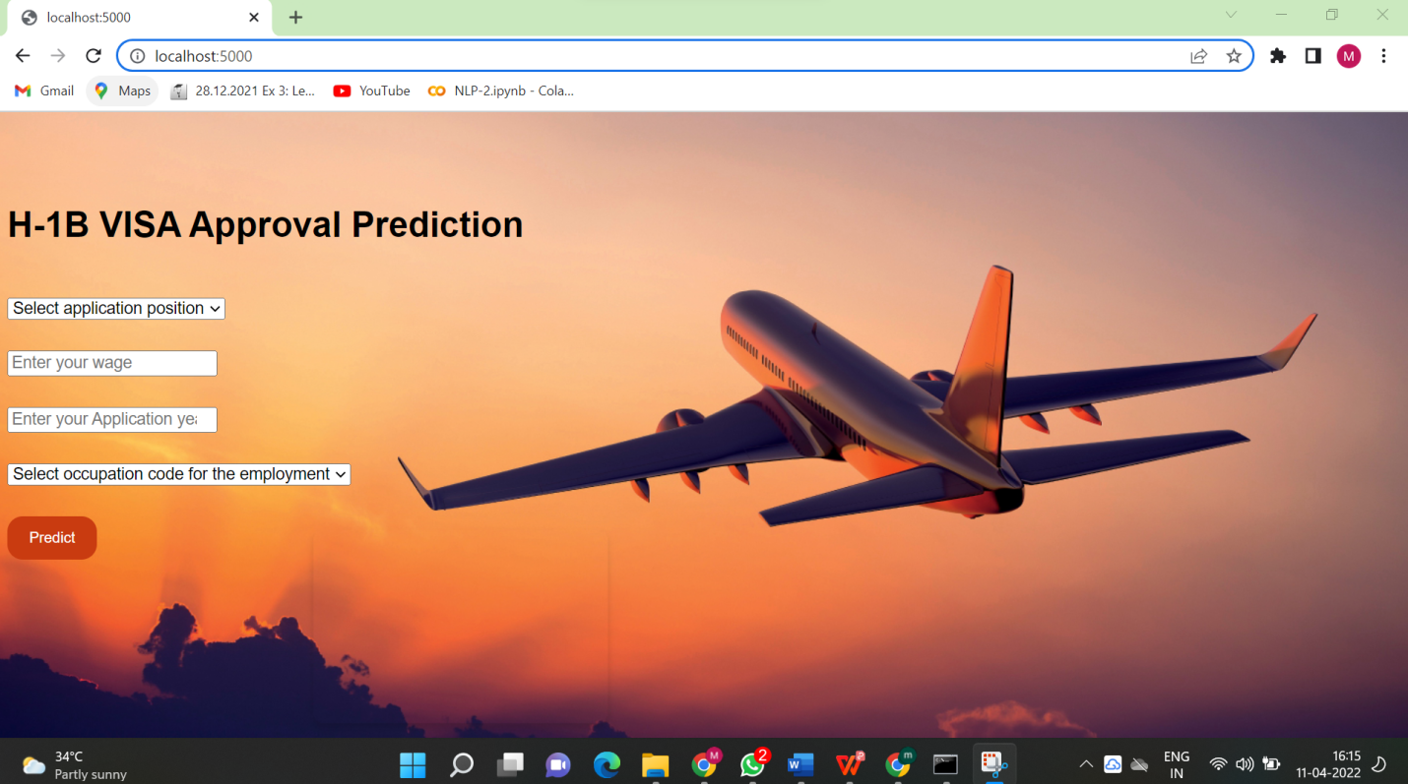
Model Screenshots

Slide 16
Model Screenshots

Slide 17

Model Screenshots

Slide 18

Model Screenshots

Slide 19
References
All Information is collected from the Internet sources like Google…
Dataset -https://www.kaggle.com/datasets/nsharan/h-1b-visa
Google Colab - https://colab.research.google.com/?utm_source=scs-index

